Slide 1


Green Hoa Lac Capstone project presentation

Slide 2


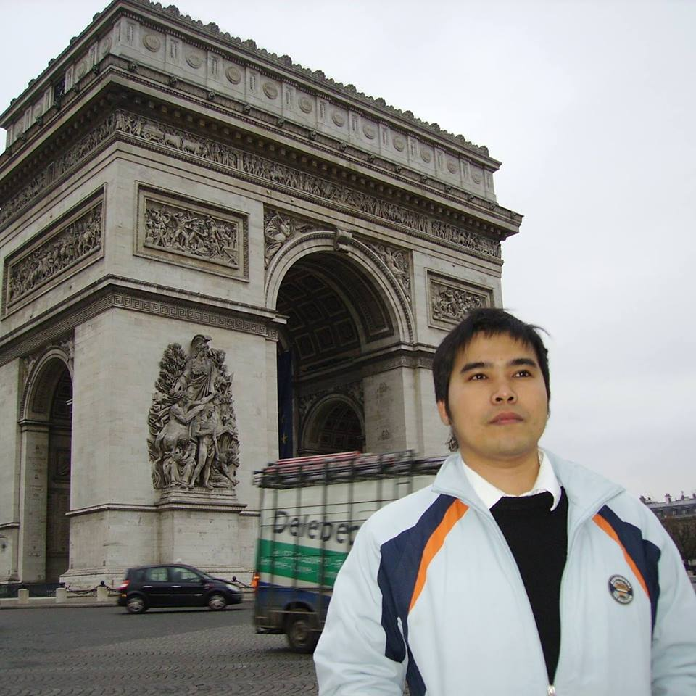




Supervisor
Technical Leader
QA
PhD. Phan Duy Hung
Mr.
Le Anh Tuyen
Ms. Nguyen Thi Ly Linh
Team Leader
Tester
Mr. Pham Quang Khang
Mr. Ho Quang Hao
Our Amazing Team
Developer
Developer
Mr. Lam Duc Thang
Mr. Bui Manh Tri
Teamwork makes the dream work!

Slide 3


TABLE OF CONTENT
01.
PROJECT OVERVIEW
02.
PROJECT
MANAGEMENT
08.
DEMO
03.
REQUIREMENTS
SPECIFICATION
07.
CONCLUSION
04. SYSTEMS
DESIGN
06.
TESTING
05.
IMPLEMENT

Slide 4




I. PROJECT OVERVIEW
CORE IDEA
EXISTING COMPETITORS
OBJECTIVES
WHY ANDROID MOBILE?

Slide 5


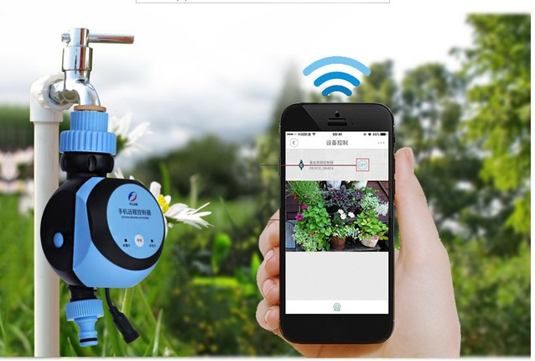
CORE IDEAS
IOT Application
Labor support
Create a remote watering system

Slide 6
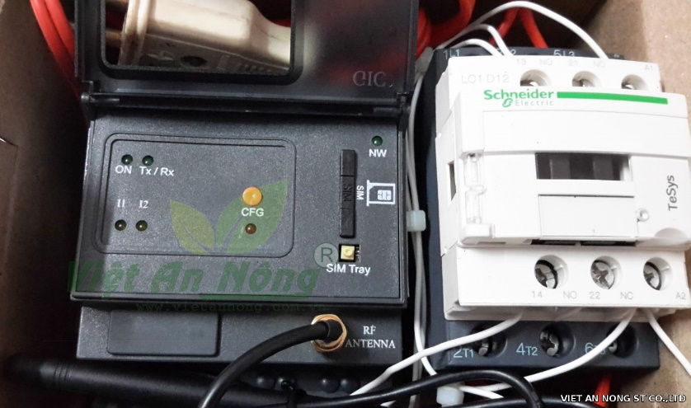
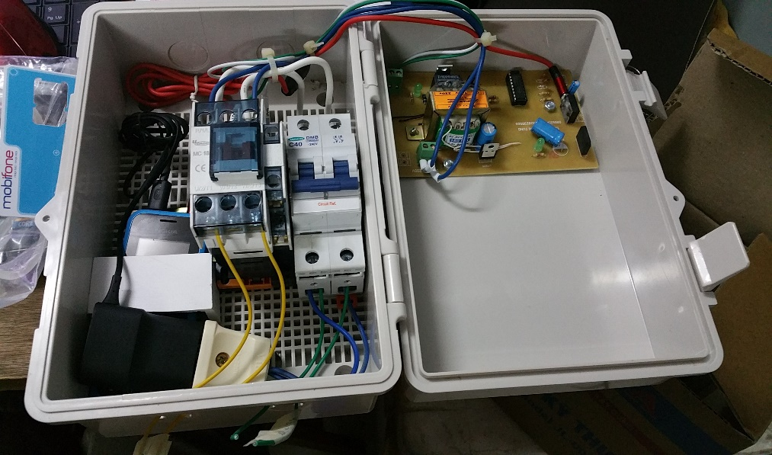
EXISTING COMPETITORS
Schneider Sprinkler Timer and Controller http://shop.vietannong.com.vn/
HT-01 Mobile phone Controller http://nongdanmuado.vn/

Slide 7


OBJECTIVES
Using and manage
Extend scope
High Stability
Smart

Slide 8
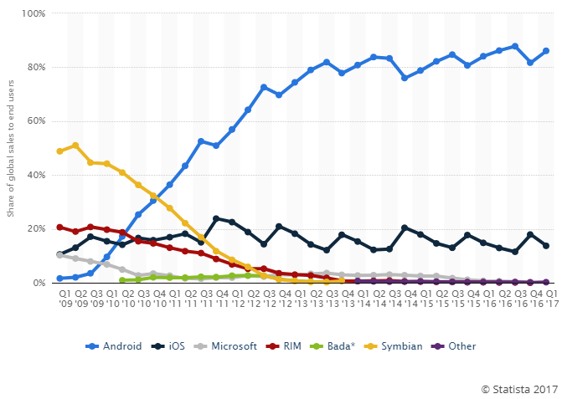
WHY ANDROID MOBILE?
The Popular and Price range of devices are larger than others
Team member Background in android
Open source OS
https://www.statista.com

Slide 9

II. PROJECT MANAGEMENT
a look at our presentation agenda!

Slide 10
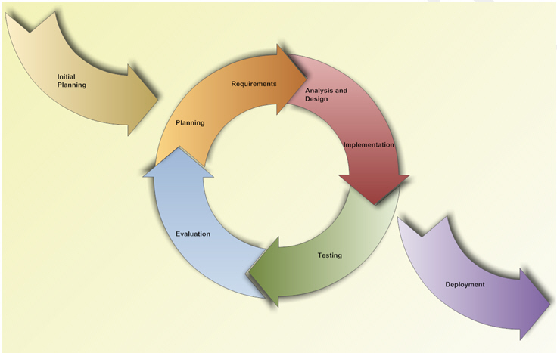
01
SYSTEM PROCESS MODEL
Interactive and Incremental Model

Slide 11
02
PROJECT ORGANIZATION
Project Leader
Pham Quang Khang
Main Supervisor
PhD. Phan Duy Hung
Technical Leader
Le Anh Tuyen
Test Leader
Ho Quang Hao
Dev Team
QA Team
Pham Quang Khang
Bui Manh Tri
Nguyen Thi Ly Linh
Nguyen Thi Ly Linh
Lam Duc Thang
Ho Quang Hao
Le Anh
Tuyen

Slide 12
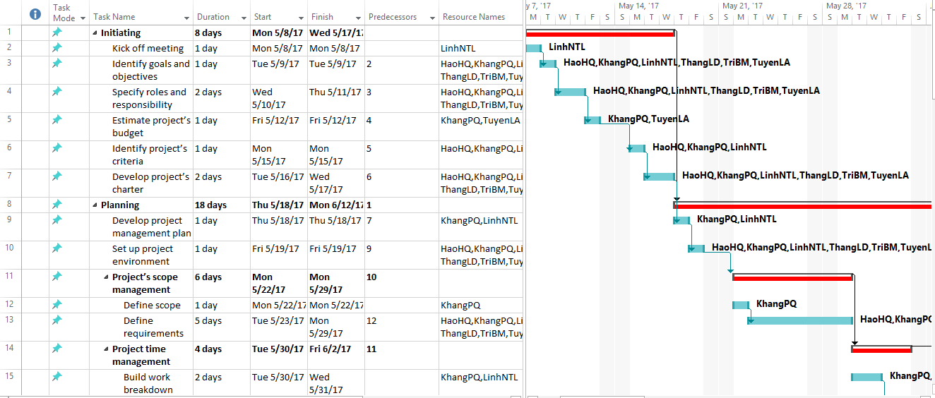
03
TASK PLAN

Slide 13









04
EQUIPMENT & TOOLS
Github
Smart GIT
Balsamiq Mockup
Fritzing
Astah
MS Office
MS Project
Window 10
mLab
Heroku

Slide 14







04
EQUIPMENT & TOOLS
Robo Mongo
Google Chrome
Postman
Web Storm
Arduino IDE
Android Studio
Google Drive

Slide 15
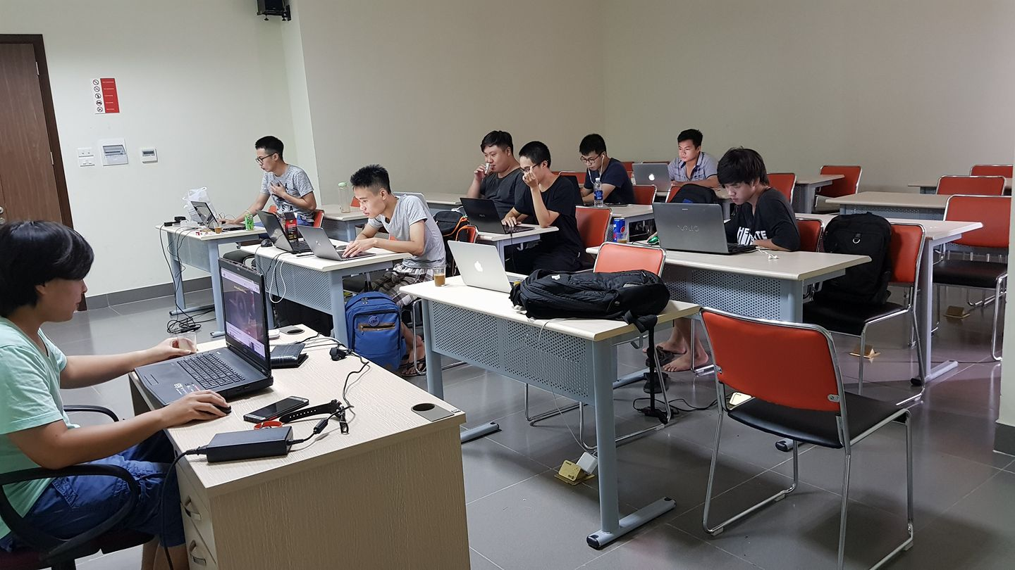


05
COMMUNICATION MANAGEMENT
Time: 3 hours / day, 5 days / week
Location: FPT University Hoa Lac
Communication:
Supervisor meeting: Once a week
Teambuilding: Once a month

Slide 16
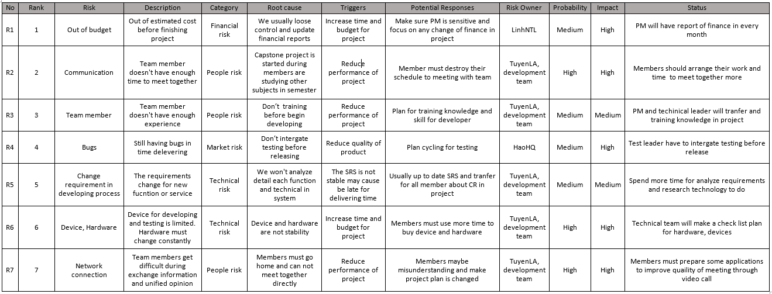
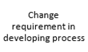
06
RISK MANAGEMENT

Slide 17


III. REQUIREMENTS
SPECIFICATION
Functional Requirement
Non - Functional Requirement

Slide 18
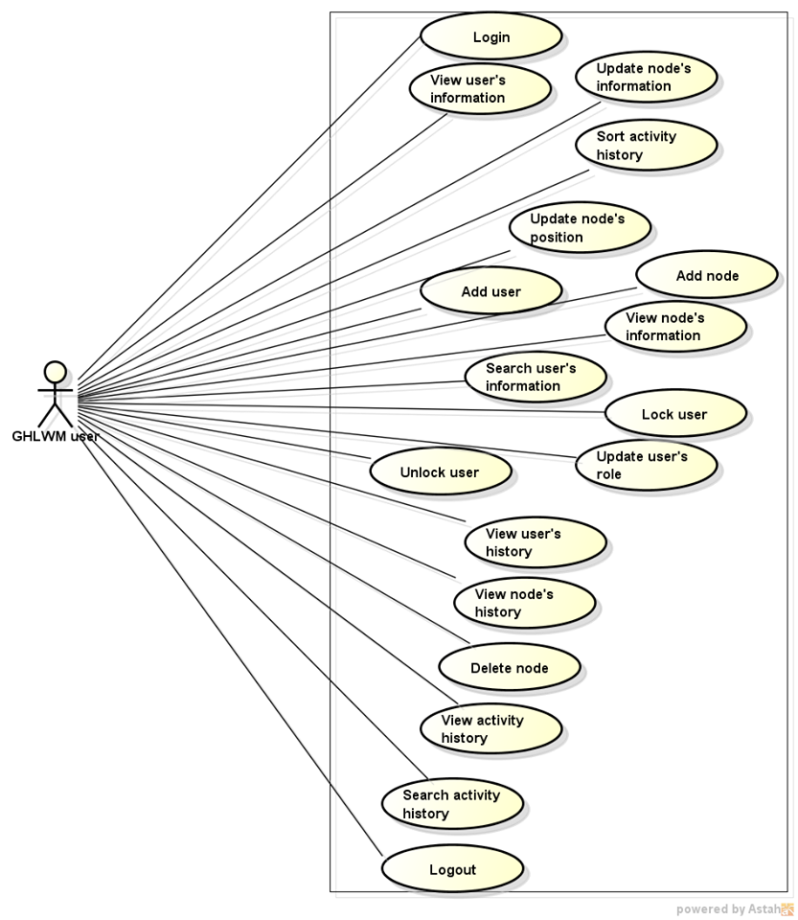
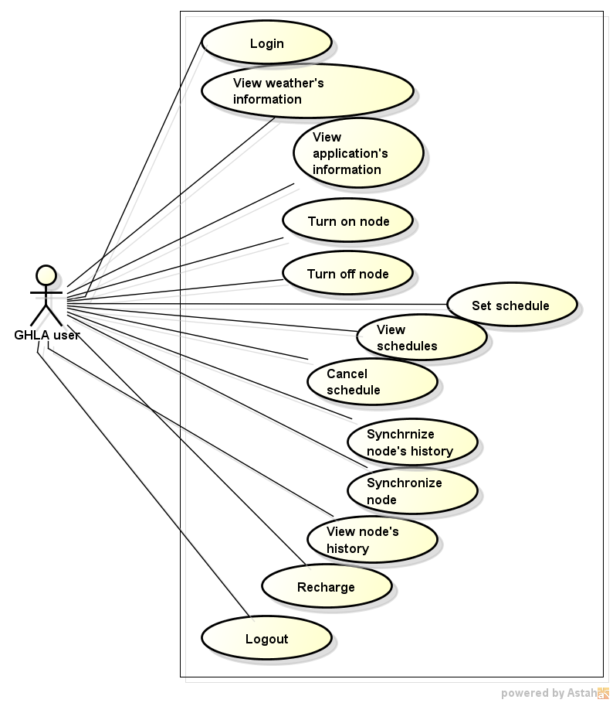
FUNCTIONAL REQUIREMENT

Slide 19



NON - FUNCTIONAL REQUIREMENT
Security
Availability
Usability

Slide 20
IV. SYSTEMS DESIGN
1
Architecture Overview
3
Hardware Design
Software Design
2

Slide 21
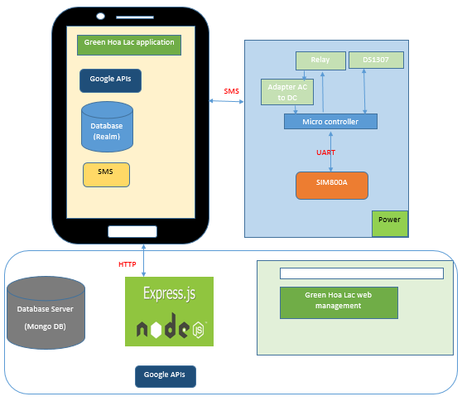
1
Architecture Overview
GSM

Slide 22


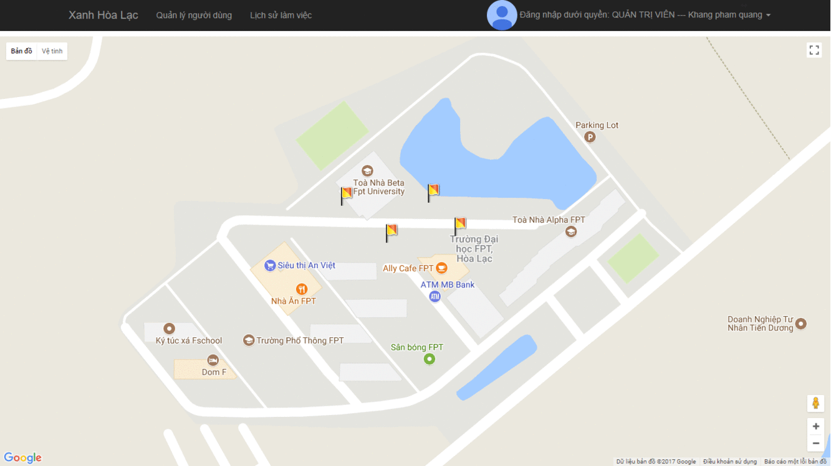
Software Design
Web Design
2
http://capstoneweb.herokuapp.com
Feature - 01
Feature - 02
Nodes Management
Users Management
Feature - 03
Feature - 04
Logs Management
Back-end RESTful api
The header of system where we manage the system, giving access role and following all of the actions from system

Slide 23










Software
Design
Web Design
2
http://capstoneweb.herokuapp.com
Server
Google APIs
HTTP
HTTP
HTTP
REST APIs
Client
Web APIs
HTTP
Android APIs

Slide 24

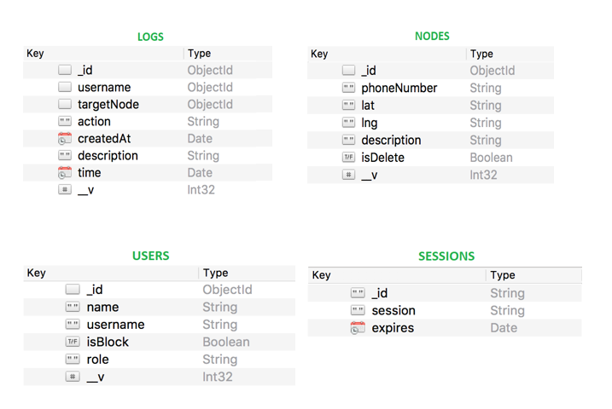
Software
Design
Web Design
2
http://capstoneweb.herokuapp.com
LOGS.username = USERS._id
LOGS.targetNode = NODES._id

Slide 25


Software
Design
Android Application Design
2
REST APIs
Google APIs
Web APIs
Android APIs
HTTP
HTTP

Slide 26
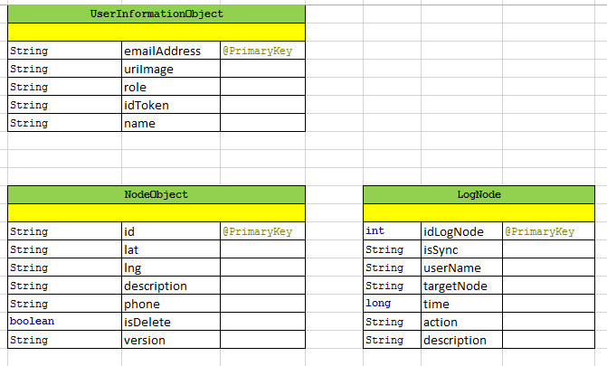
Software
Design
Android Application Design
2

Slide 27

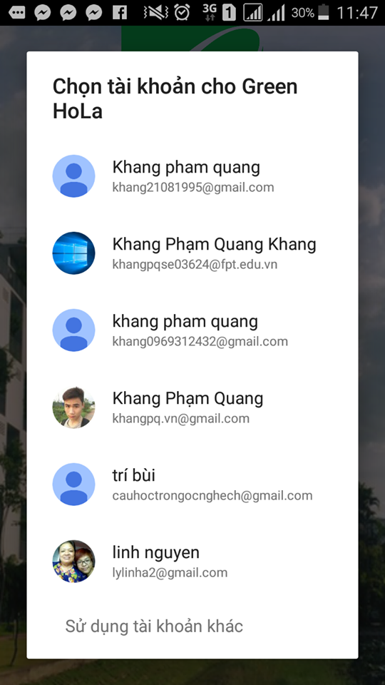
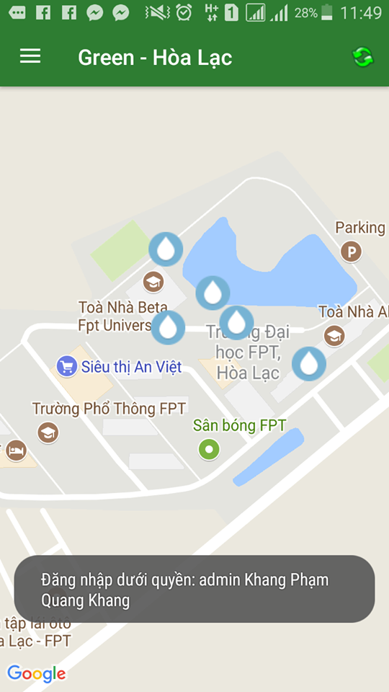
Software
Design
Android Application Design
2
LOGIN

Slide 28
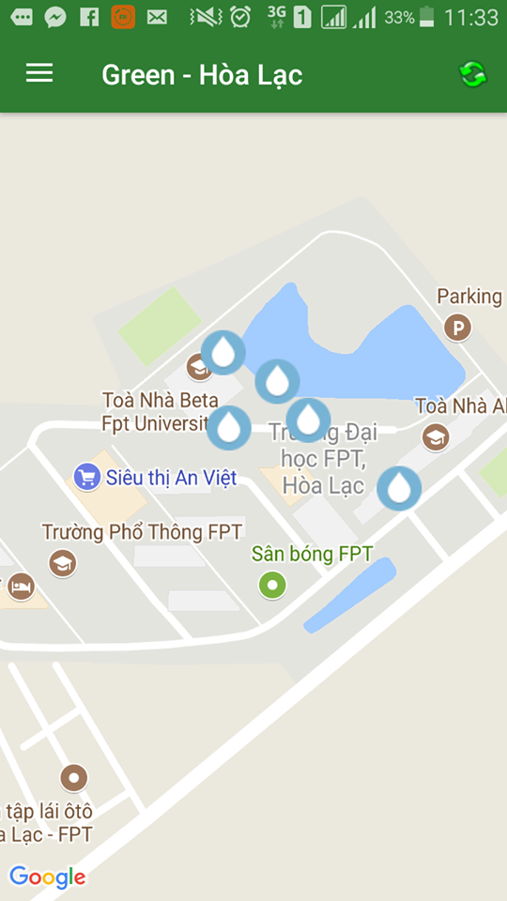
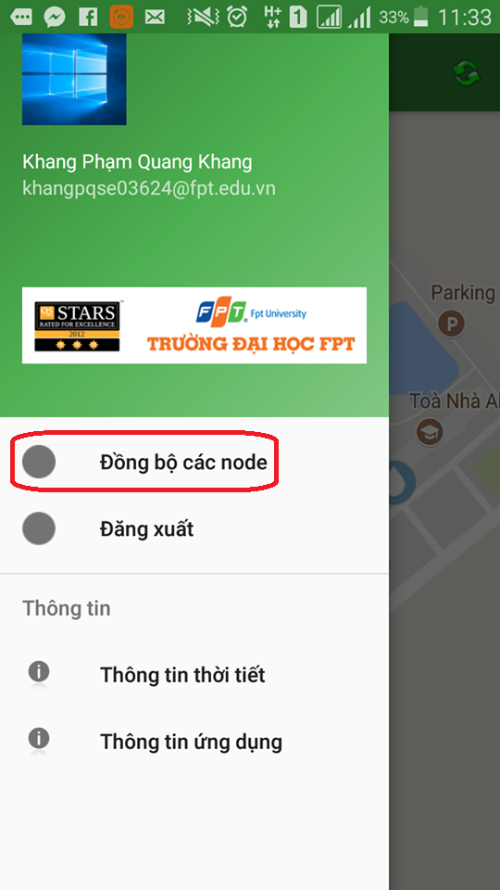
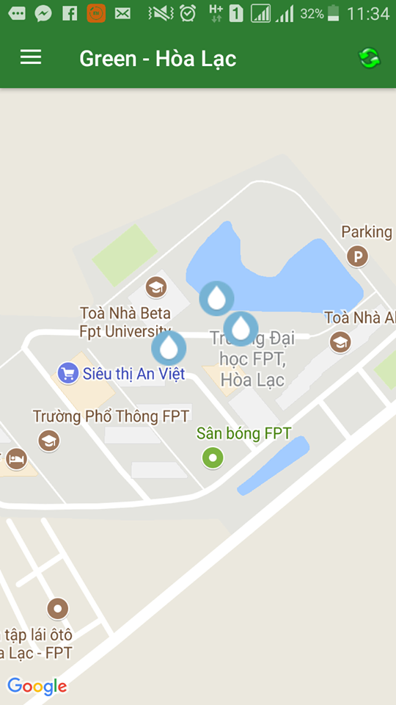
Software
Design
Android Application Design
2
SYNCHRONIZER

Slide 29
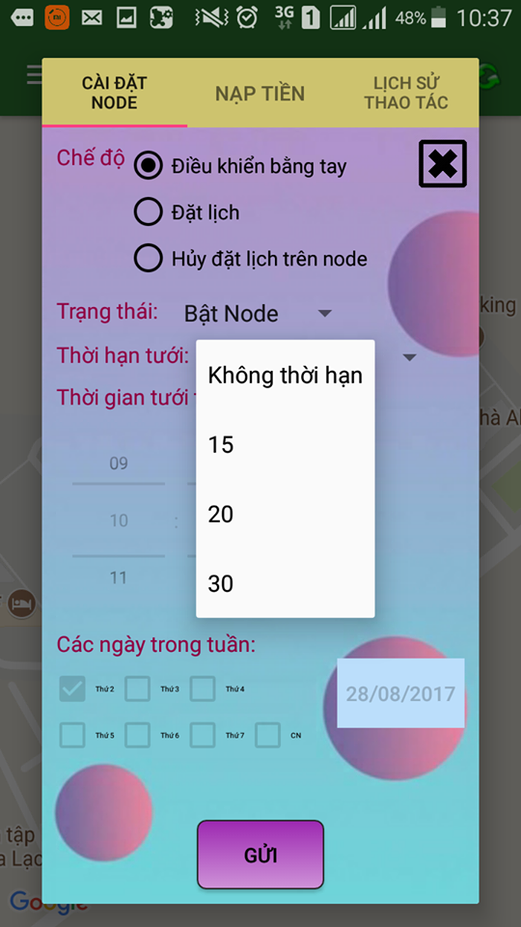
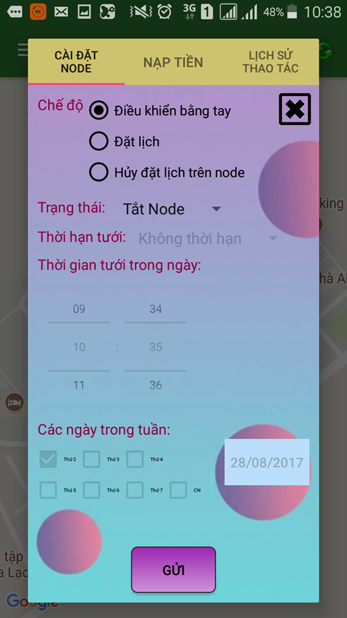
Software
Design
Android Application Design
2
NODE SETTING

Slide 30

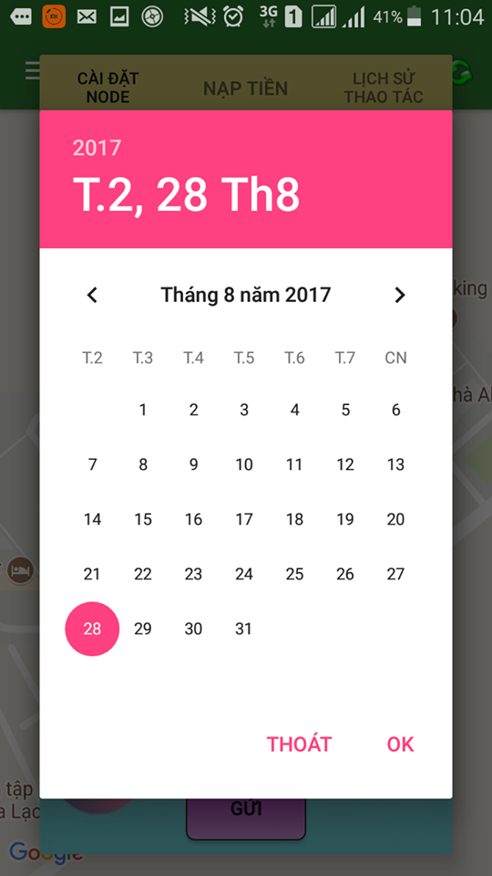
Software
Design
Android Application Design
2
NODE SETTING

Slide 31
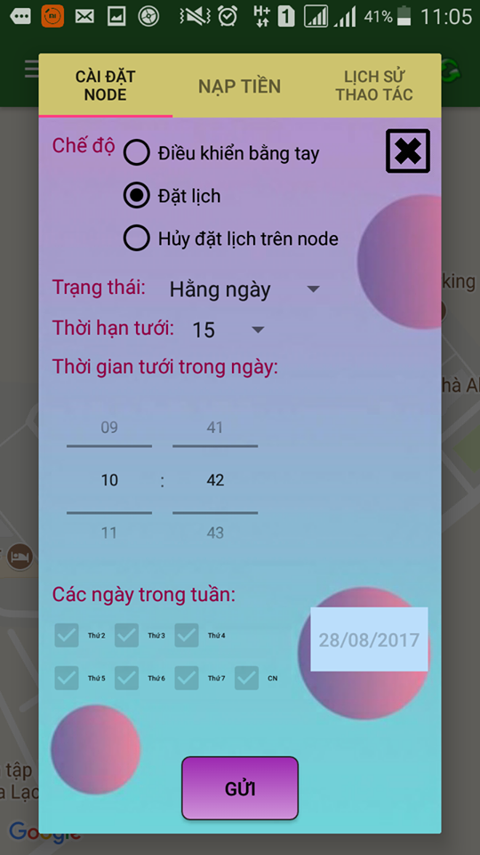
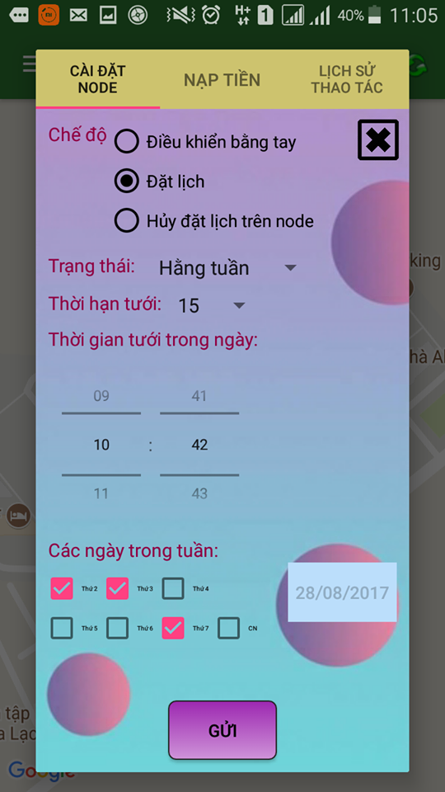
Software
Design
Android Application Design
2
NODE SETTING

Slide 32
Software
Design
Android Application Design
2
NODE SETTING

Slide 33

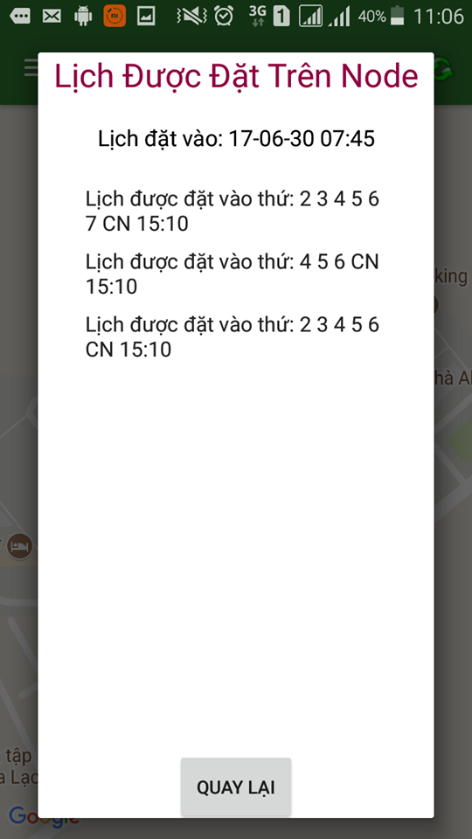
Software
Design
Android Application Design
2
NODE SETTING

Slide 34
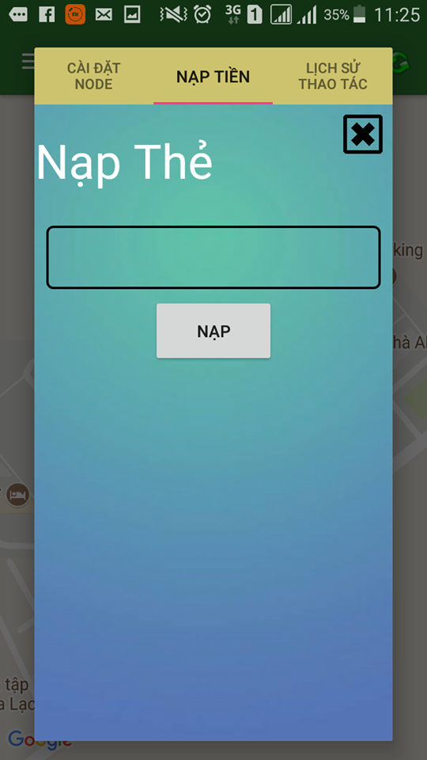
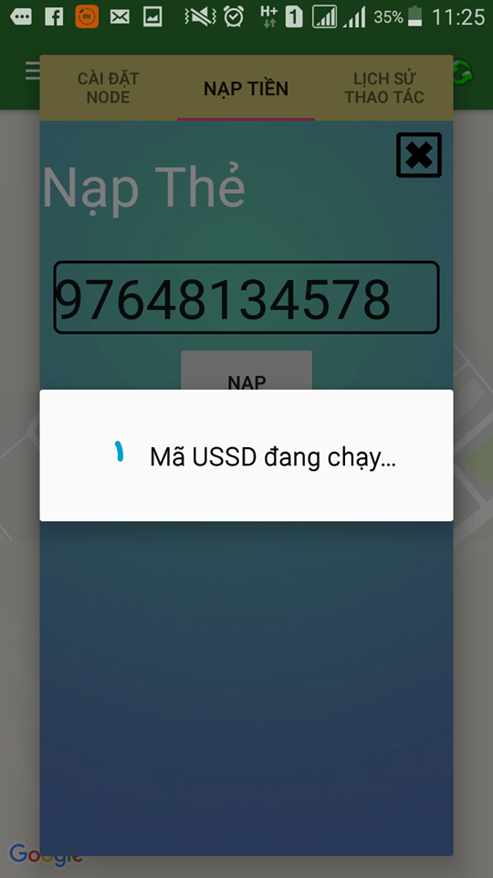
Software
Design
Android Application Design
2
RECHARGE

Slide 35
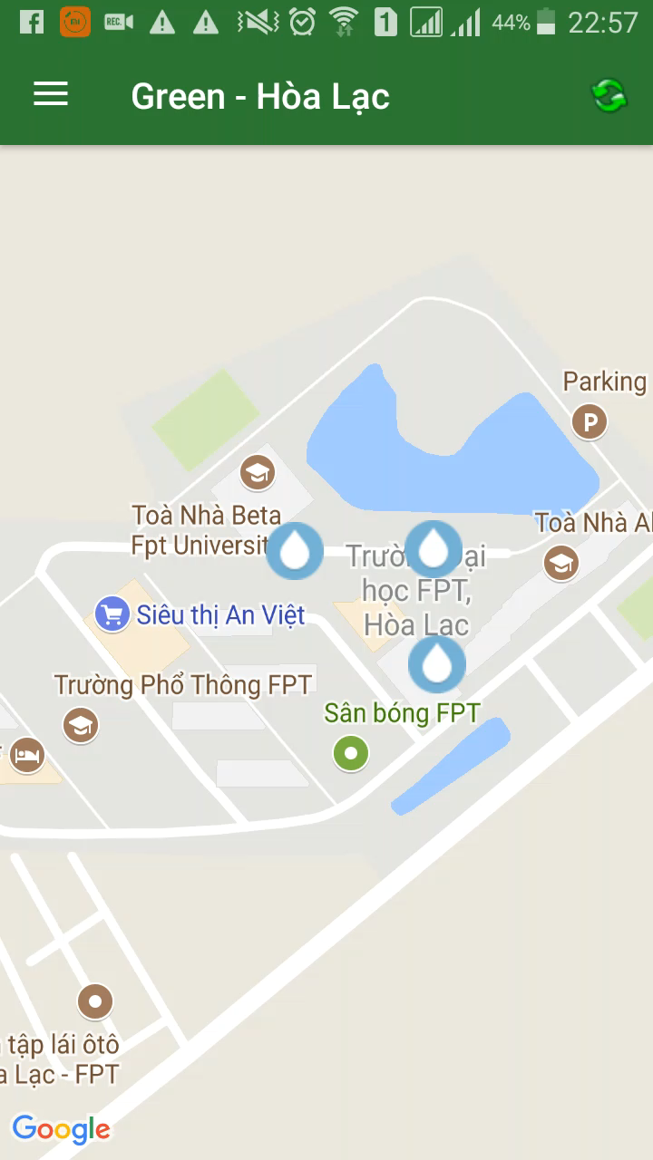

Software
Design
Android Application Design
2
WEATHER FORECAST

Slide 36
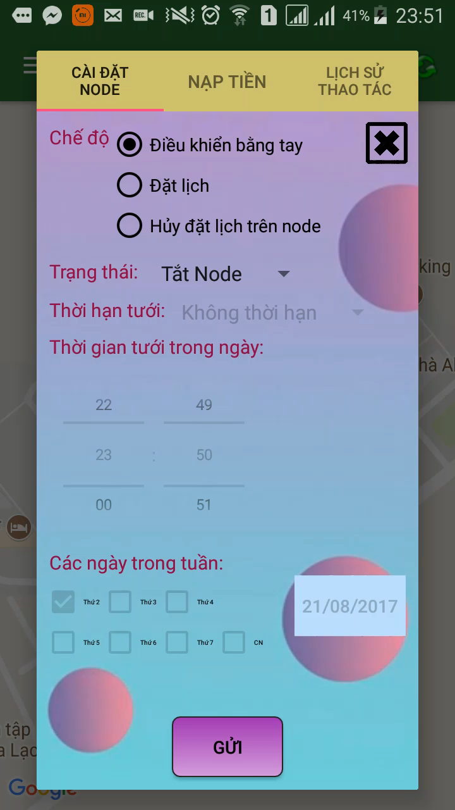
Software
Design
Android Application Design
2
HISTORY OF ACTION

Slide 37
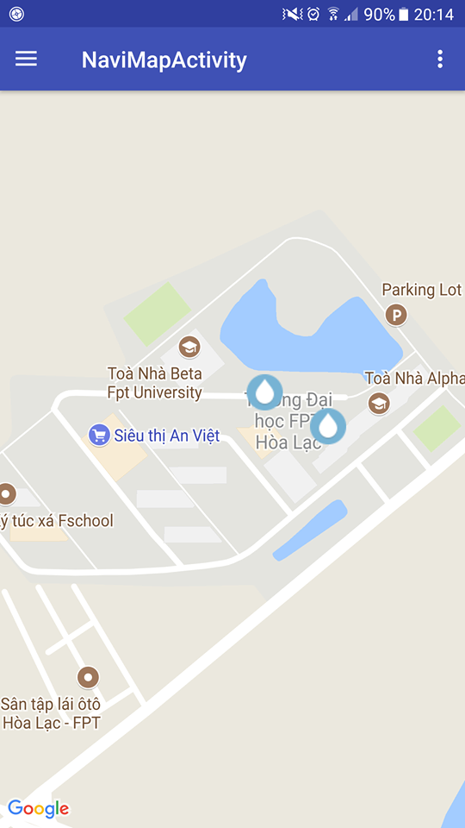


Software
Design
Android Application Design
2
OFFLINE-MODE
Auto sing-in without checking from web server.
Auto load google map api state .
Auto load information from Realm Database.

Slide 38
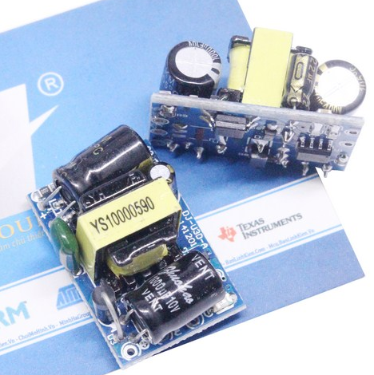
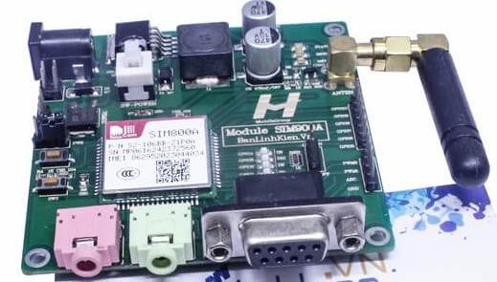
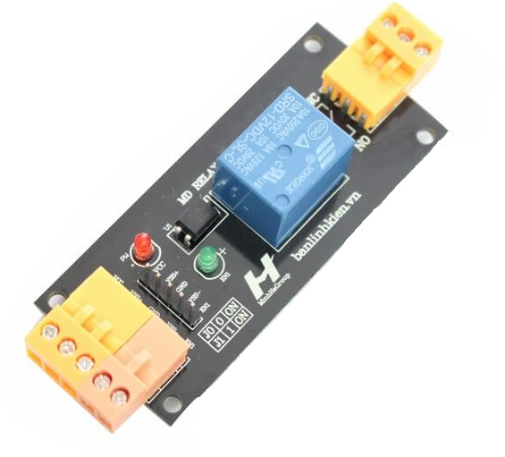
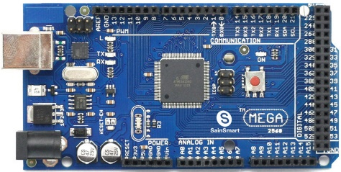
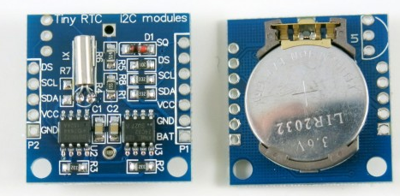
3
Hardware Design
List of Hardware
Arduino MEGA 2560
SIM 800A MH
RTC DS1307
Relay
Adapter
AC 220V to DC 5V
Realtime clock
Export data via I2C communication
Over 10 years external battery
Microcontroller : ATmega2560
High Performance, Low Power Atmel® 8-Bit Microcontroller
Flash Memory: 256KB
SRAM: 8KB
[ Atmel® Microcontroller ATmega640-1280/1281/2560/2561 Datasheet ]
Clock: 16MHz
Digital, UART, I2C, ...
Based on SIM 900A V1 Module’s PCB
Frequency bands: 850/900/1800/1900 MHz
Vietnam GSM Frequency Bands: 900/1800 MHz
[Cục Tần số vô tuyến điện, Bộ TTTTVN 2015 - http://forum.rfd.gov.vn ]

Slide 39
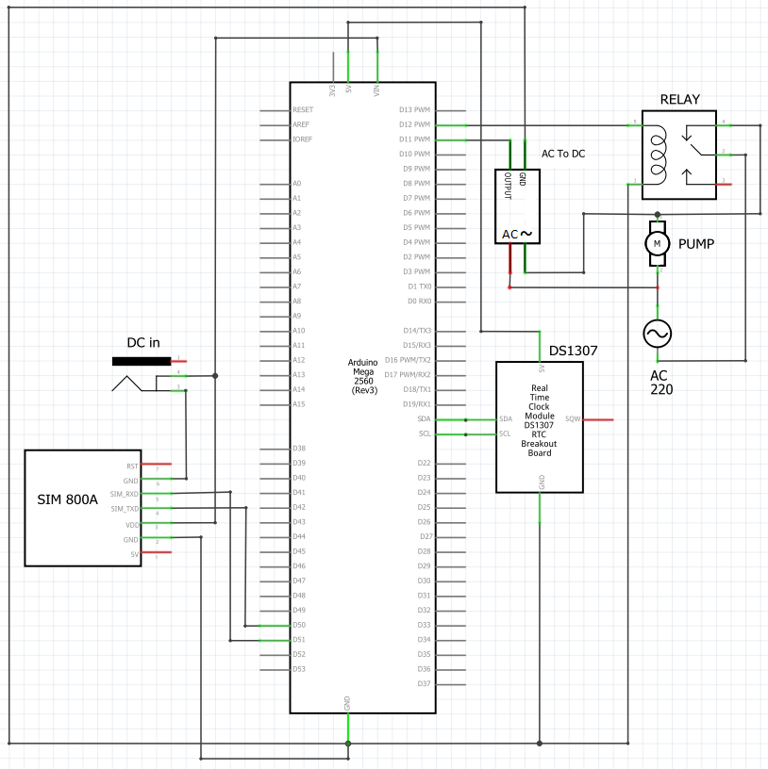
3
Hardware Design
Schematic Design

Slide 40
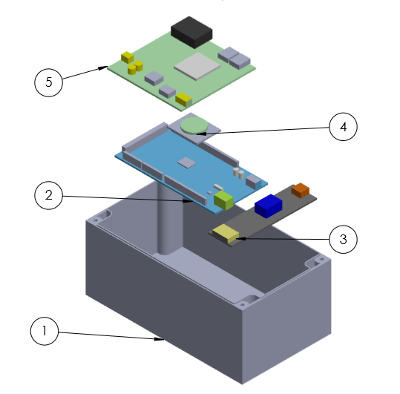
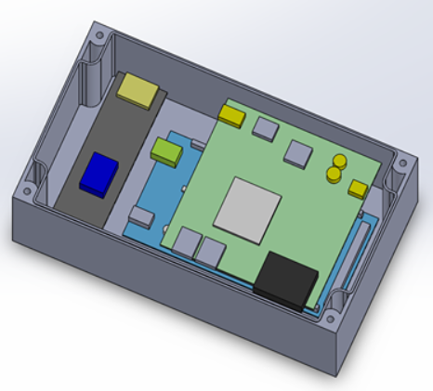
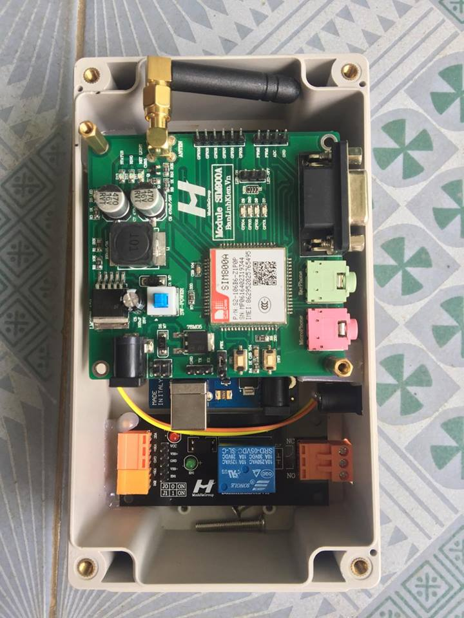
3
Hardware Design
Mechanical Design

Slide 41
Hardware Design
3
Main functions
- Turn ON/OFF device
- Turn ON with/without setting time OFF
- Schedule once
- Schedule multi-time
- View/Delete schedule
- Run schedule automatically
- Control by session
- Overwrite permission access
- Automatically turn OFF and notify when device doesn’t work correctly
- Warn account <10000 VND automatically

Slide 42
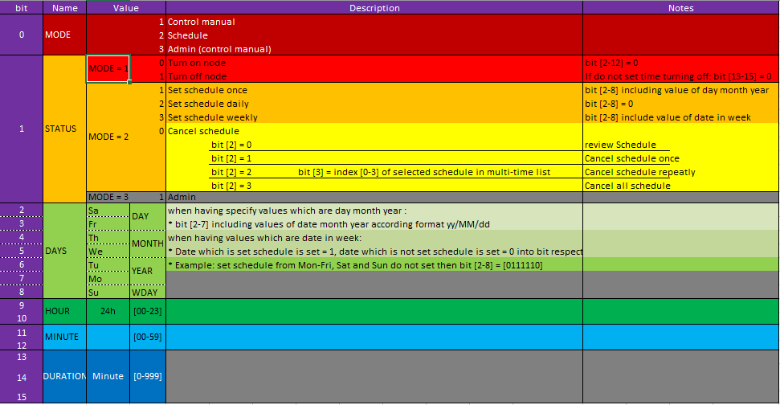
Hardware Design
3

Slide 43
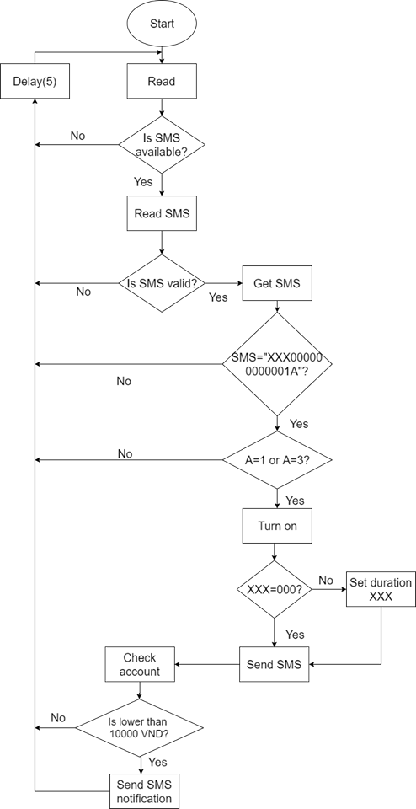
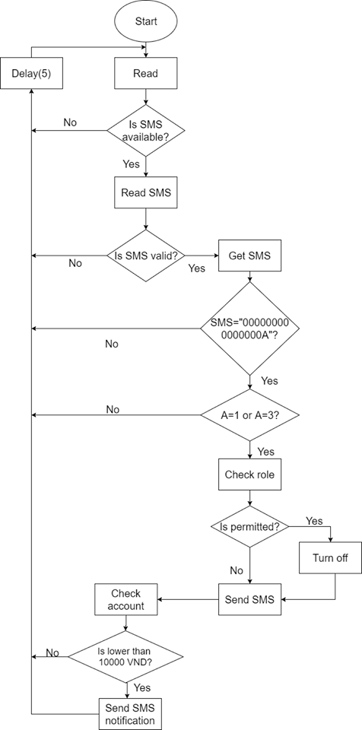
Hardware Design
Get ON
Get OFF
3
Flow chart

Slide 44
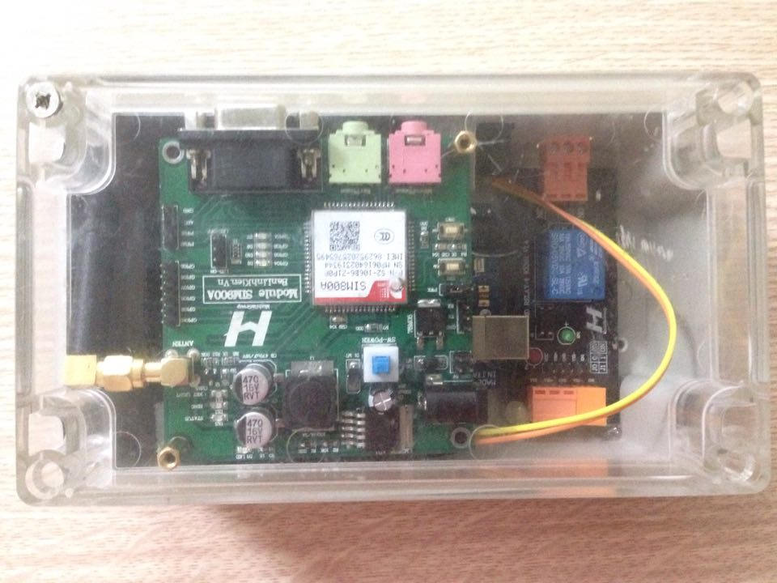
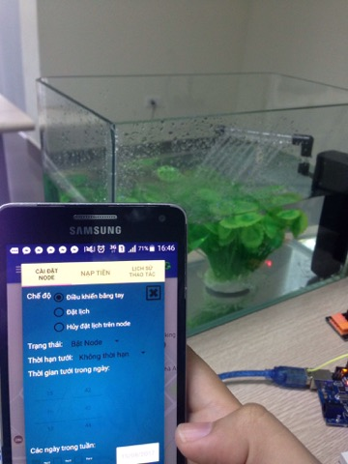
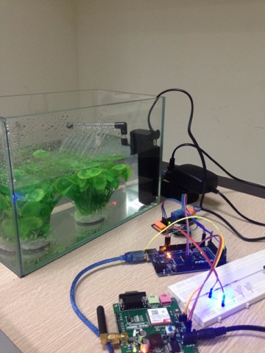
V. IMPLEMENT

Slide 45
VI.
Testing

Slide 46




01
TESTING TOOL

Slide 47
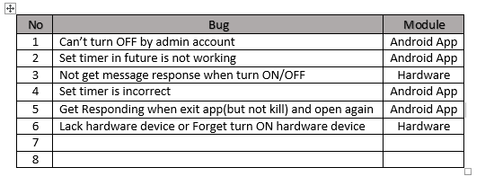
02
TEST EVIDENCE

Slide 48
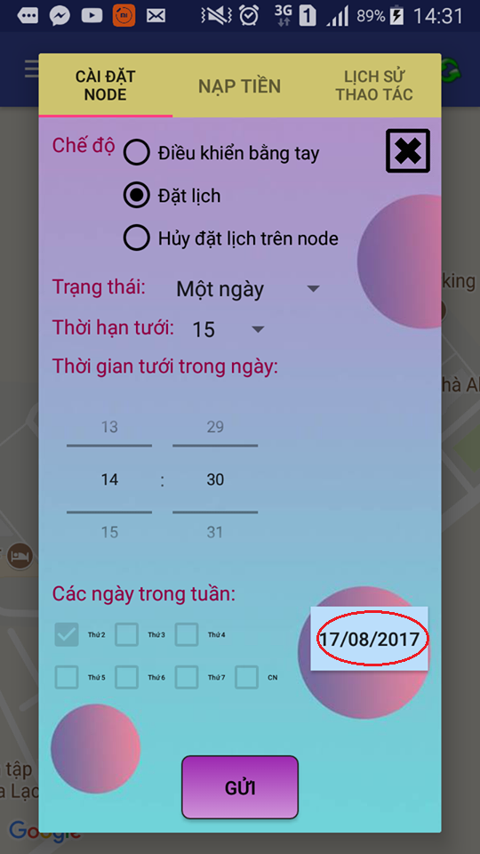
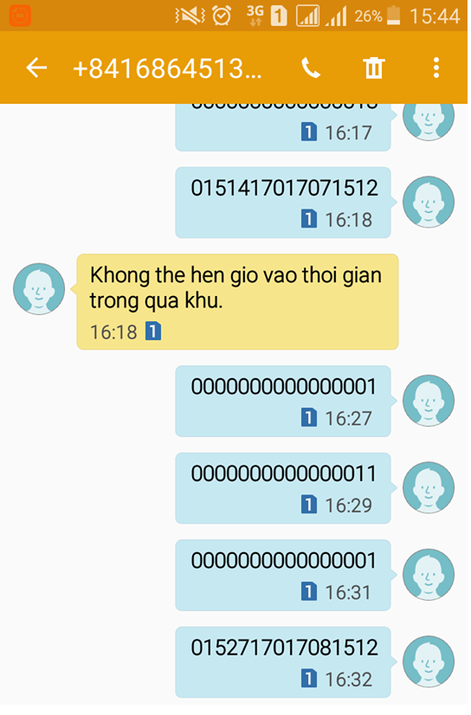
02
TEST EVIDENCE

Slide 49



02
TEST EVIDENCE

Slide 50


02
TEST EVIDENCE

Slide 51


02
TEST EVIDENCE

Slide 52


02
TEST EVIDENCE

Slide 53


02
TEST EVIDENCE

Slide 54
02
TEST EVIDENCE

Slide 55


02
TEST EVIDENCE

Slide 56


02
TEST EVIDENCE

Slide 57


VII. CONCLUSION

Slide 58




VII. CONCLUSION
Teamwork
Business Analysis
Management Skill
New Knowledge

Slide 59

VIII. DEMO Q&A

Slide 60
Thanks for watching!

